Slide 1
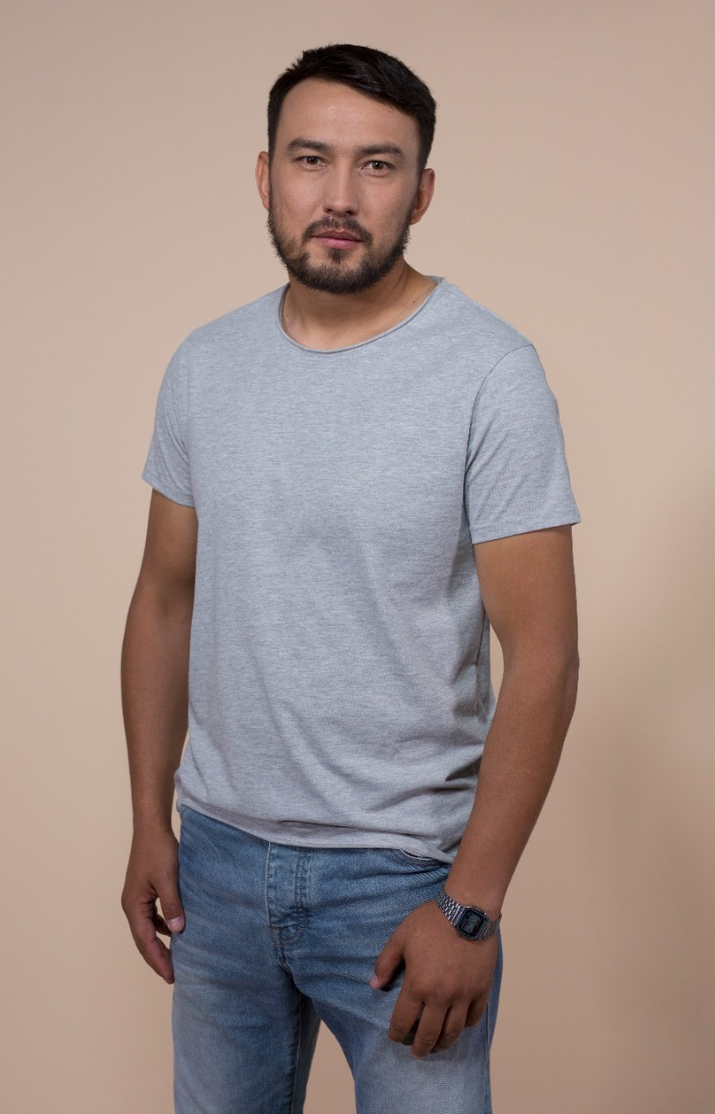
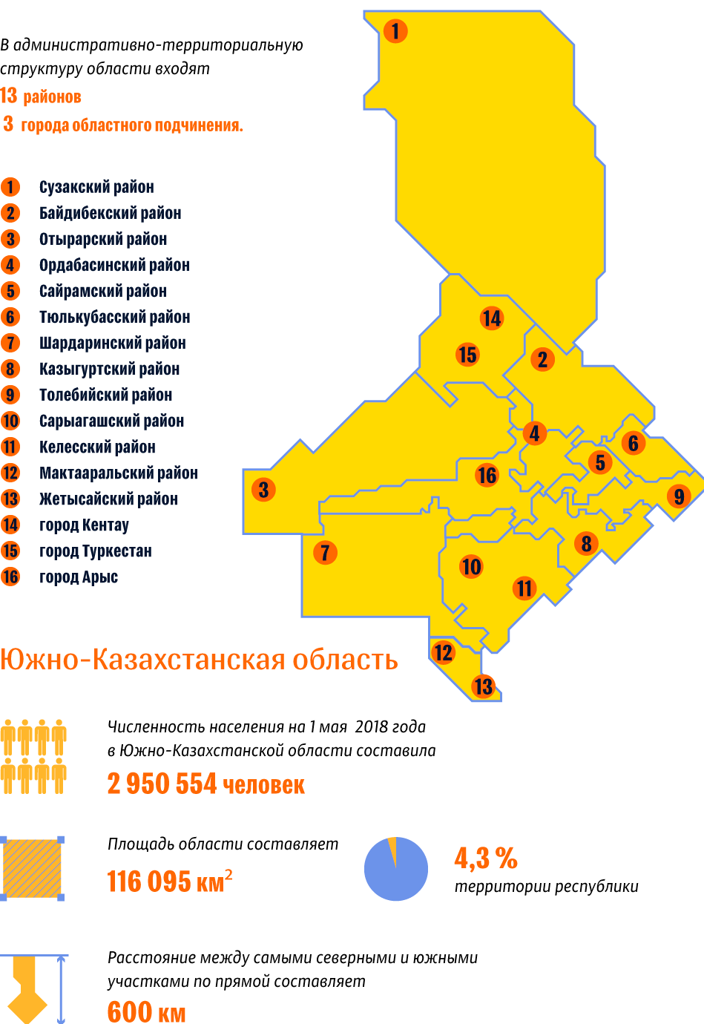
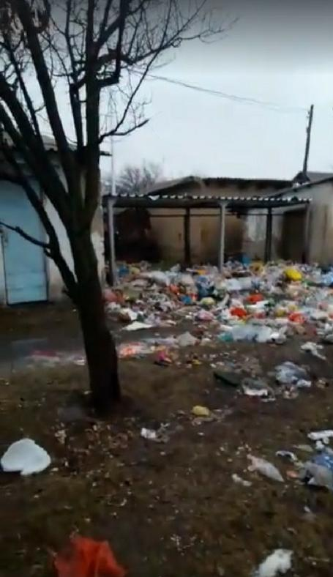
“History”

Slide 2
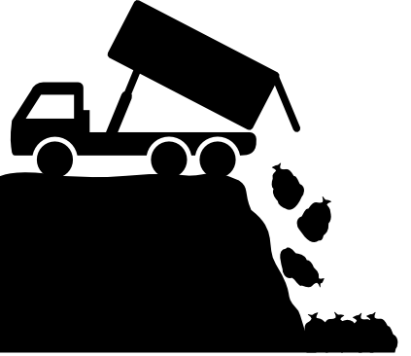

3300 landfills
125 mln tons of solid municipal waste
5 mln tons of solid municipal waste

Slide 3

82%
of recycled solid waste are
removed to landfills

Slide 4



8 out of 10 people

Slide 5

20%
Solid waste removal charges
Non-paying costumers

Slide 6
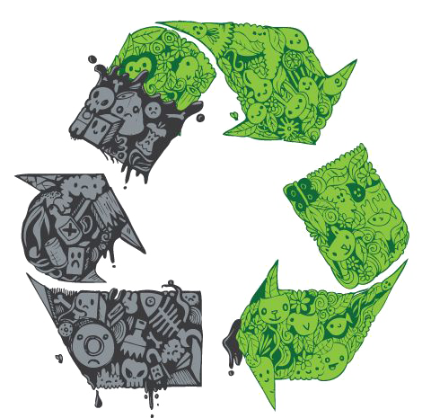
“Eco Cashback”

Slide 7

Mission: To raise value of waste
Objective: Creation of a unified waste management service system with payments for waste separate disposal

Slide 8

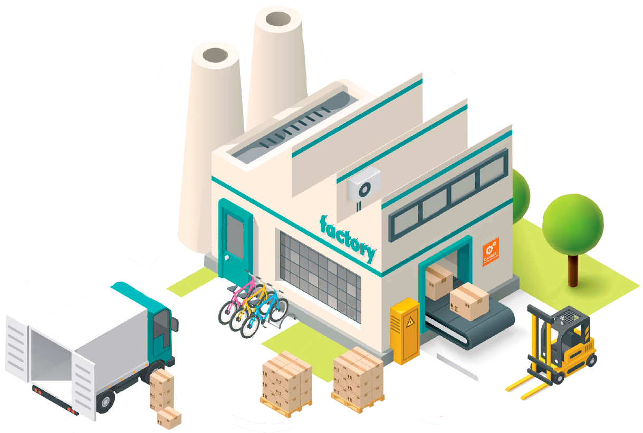

“Eco Cashback”
Service Company
Customers

Slide 9
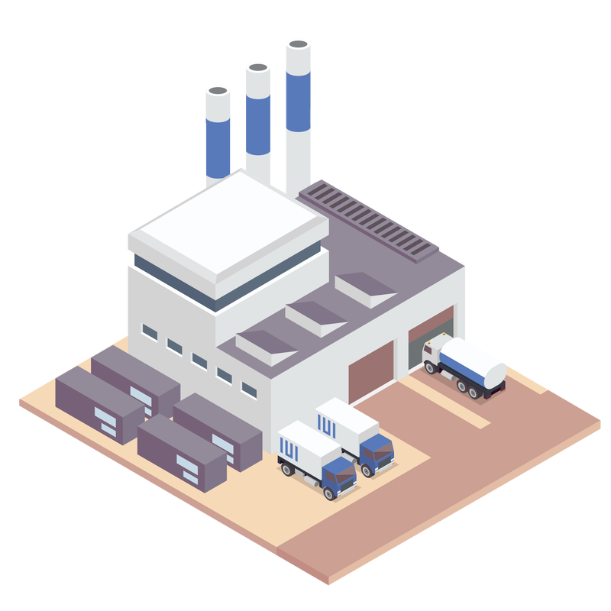
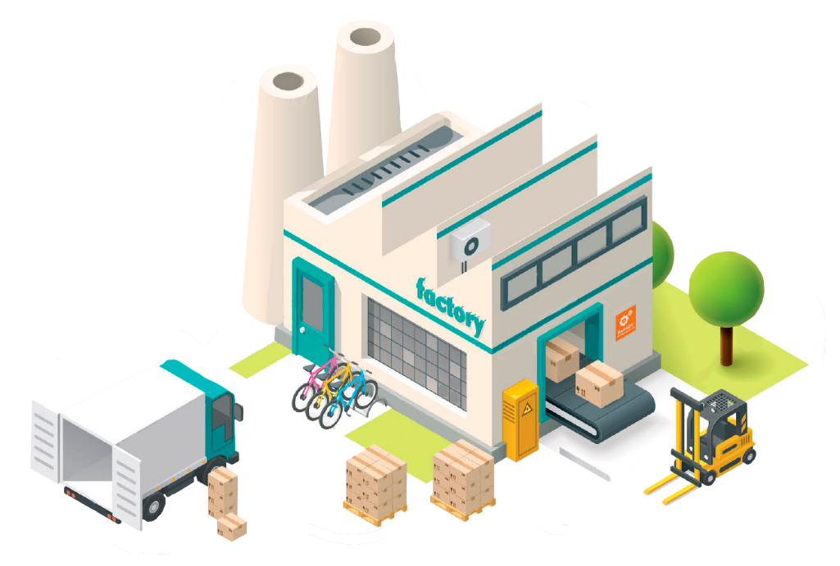
“Eco Cashback”
Service Company
Partners

Slide 10

“Eco Cashback”
Service Company
Partners

Slide 11
“Eco Cashback”
Service Company
Customers

Slide 12
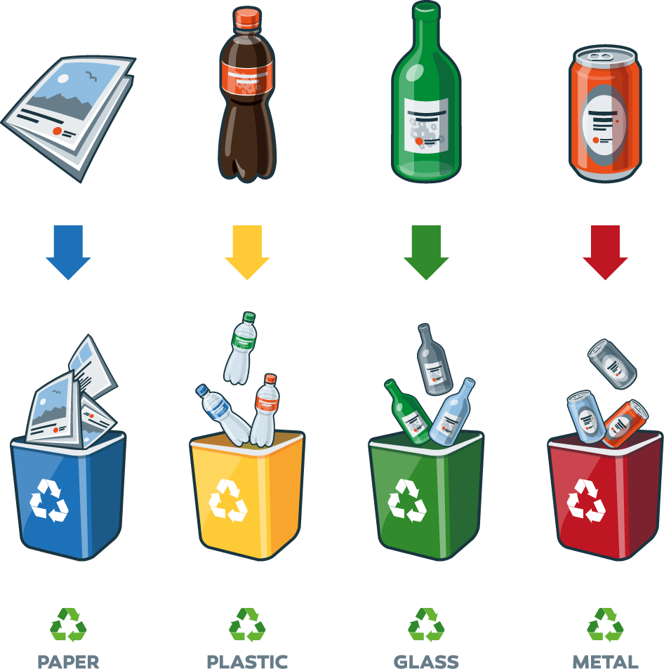
72kg
annually

Slide 13



34 organizations
117 SMEs
72 multi-apartment residential buildings

Slide 14

358 800
kilograms
4600
customers

Slide 15



29 900
kilograms
80 tenge

Slide 16

28 704 000 tenge
2 392 000 tenge

Slide 17


Bank
“Eco Cashback”
Business account

Slide 18



“Eco Cashback” Service

Slide 19

“Eco Cashback” Franchise

Slide 20

“Let us turn waste into a part of the economy,
not part of waste dumps and landfills”

Slide 21

Contacts
Instagram: @eco_cashback
Tel.: +7 705 484 4430
email: vladislav.golyarko@mail.ru

